Slide 1


Lecture 20.2
Classification trees and RandomForest
Tim Gorman, Flickr, CC-BY-ND-2.0
Nicola Romanò
nicola.romano@ed.ac.uk

Slide 2
Learning objectives
At the end of this lecture you should be able to:
Explain the usage of binary trees as a classification method
Explain how RandomForests improves on binary tree classification
Explain the concept of bagging and how can it improve classification
R workshop #6 will show you how to use these techniques more in detail
Notes:
Pancreas, genotype
1

Slide 3
Binary trees
One of the simplest method of classification
Can be used to predict binary data (classification tree) or continuous data (regression tree)
Altogether known as CART (Classification And Regression Trees) (Breiman et al. 1984)
Work by partitioning data into two subsets, in a recursive way, until all data is classified.
Notes:
Pancreas, genotype
1

Slide 4
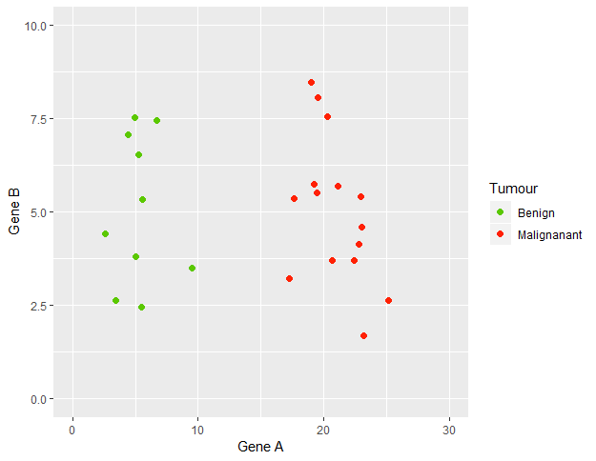
A simple example
What is the easiest way to classify benign vs malignant tumours from levels of A and B?
Notes:
Pancreas, genotype
1

Slide 5
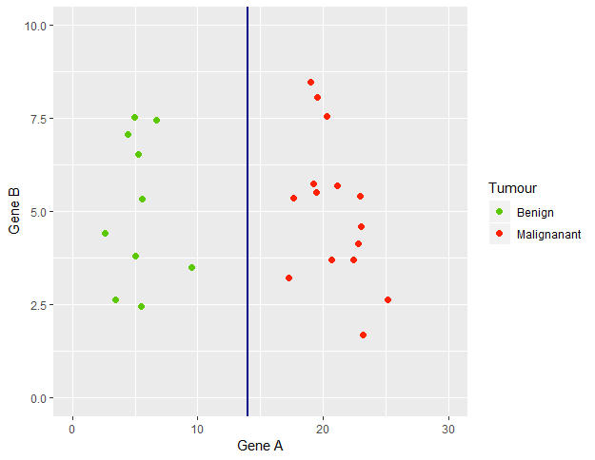
A simple example
If A >= 14 → malignant
If A < 14 → benign
Notes:
Pancreas, genotype
1

Slide 6
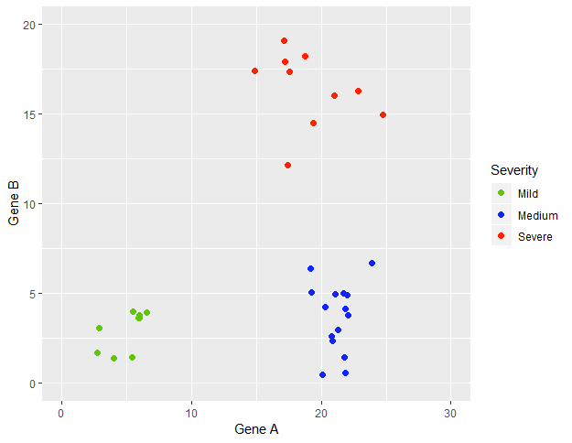
A simple example
What is the easiest way to classify the severity of the disease?
Notes:
Pancreas, genotype
1

Slide 7
A simple example
If A < 10 → mild
If A >= 10
If B < 10 → medium
If B >= 10 → severe
Notes:
Pancreas, genotype
1

Slide 8
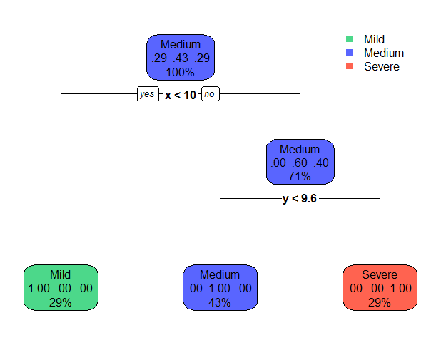
Binary trees
Predicted class
Probability of each class
% observations
A < 10
B < 10
If A < 10 → mild
If A >= 10
If B < 10 → medium
If B >= 10 → severe
Notes:
Pancreas, genotype
1

Slide 9
Some nomenclature
Root node
Split
y < 10
Leaf node
Branch
If x < 10 → mild
If x >= 10
If y < 10 → medium
If y >= 10 → severe
Notes:
Pancreas, genotype
1

Slide 10
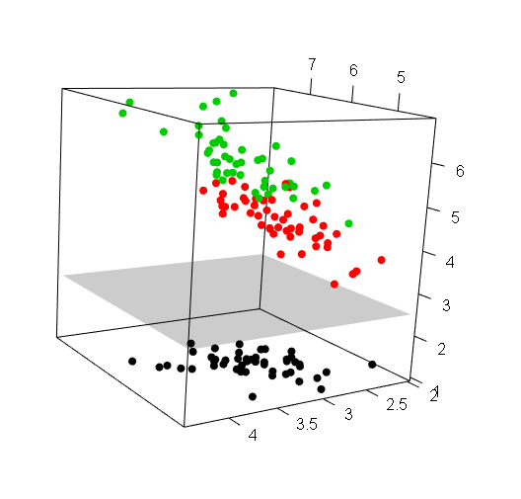
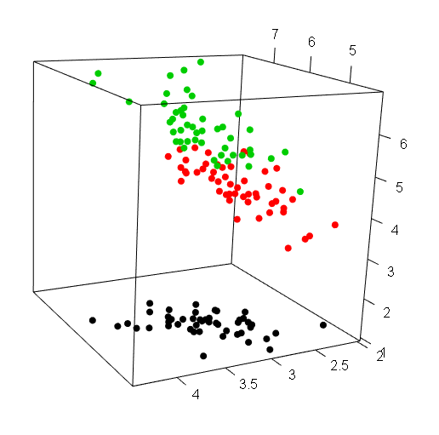
More complex/real situations
What if we have multiple descriptors?
Our binary splits will become (hyper)planes
Notes:
Pancreas, genotype
1

Slide 11
Creating a binary tree in R
library(rpart)
library(rpart.plot)
# Generate the model
# Just pass a formula and the dataset!
model <- rpart(Output ~ Predictor1 + Predictor2, data = mydata)
# Plots the model
rpart.plot(model)
Notes:
Pancreas, genotype
1

Slide 12
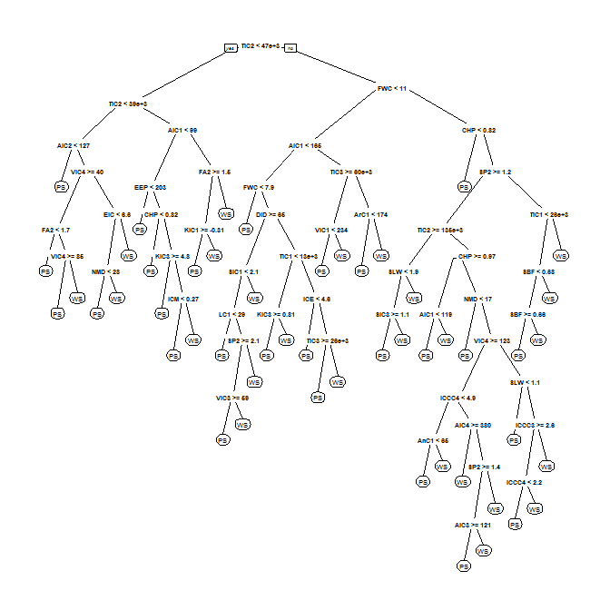
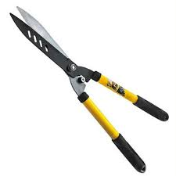
Pruning
Sometimes the resulting tree can be too complex, with the risk of overfitting
Pruning allows to “cut back” some splits and simplify the tree, generally improving prediction
Notes:
Pancreas, genotype
1

Slide 13
How does rpart choose a split?
The recursive partitioning approach
Find the variable which best splits the data
Split the data on that variable and repeat the process for each branch
Stop when:
  The subgroups reach a minimum size
  or
  No improvements can be made
  This depends on the cp parameter that is related to the probability of increasing misclassification if making a new split
Prune back the tree to improve classification rate
Notes:
Pancreas, genotype
1

Slide 14
Pruning
Two main ways of pruning an rpart tree
Specifying the control parameter in rpart
  Can control several aspects of how the tree is generated
  minsplit → minimum number of observations to try and split a node
  minbucket → minimum number of observation in a leaf
  cp → complexity parameter
  … others left to you to find out!
# Minimum 10 elements for a split
my.tree <- rpart(Output ~ .,
control = rpart.control(minsplit = 10))
# Minimum 10 elements for a split
# Minimum 3 elements in each leaf
my.tree2 <- rpart(Output ~ .,
control = rpart.control(minsplit = 10,
minbucket = 3))
  Using the prune function on an existing tree. Needs a complexity parameter cp
my.tree.pruned <- prune(my.tree, cp = 0.1)
Notes:
Pancreas, genotype
1

Slide 15
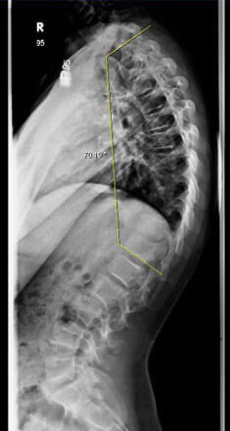
Predicting risk of kyphosis
81 children with corrective spinal surgery
Kyphosis (excessive convex spine curvature) is a possible side effect of corrective surgery
Can we predict the risk of kyphosis?
Dataset from 81 patients
Age (in months) at time of surgery
Number of vertebrae involved in the surgery
Start: first vertebra operated on
Notes:
Pancreas, genotype
1

Slide 16
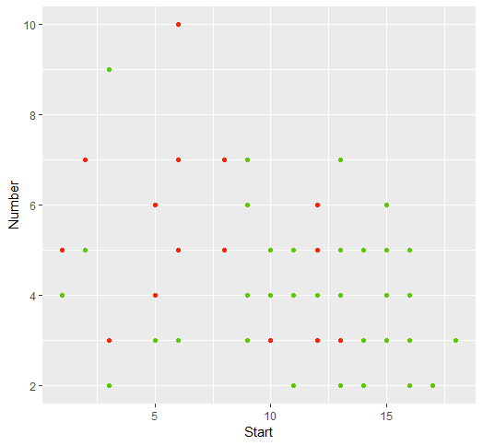
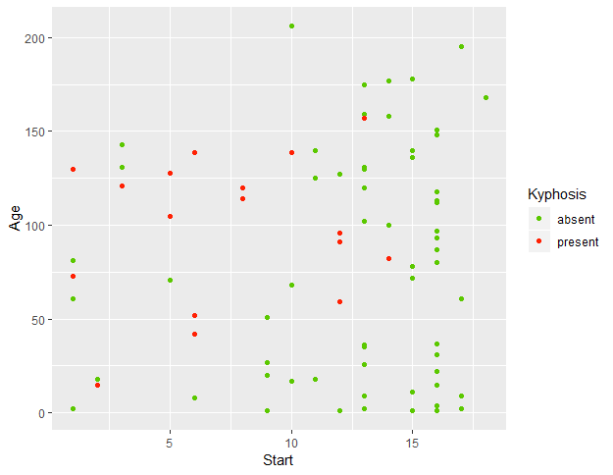
A quick look at the data
Difficult to manually define a split (generally the case with real-life data!)
Notes:
Pancreas, genotype
1

Slide 17
Creating a training set
# Get 65 numbers from 1 to 81 (the number of patients)
training.id <- sample(1:81, size = 65)
# Subset our data into a training set and a test set
training <- kyphosis[training.id,]
test <- kyphosis[-training.id,]
We can now train our tree on the training set and test it on the test set.
Notes:
Pancreas, genotype
1

Slide 18
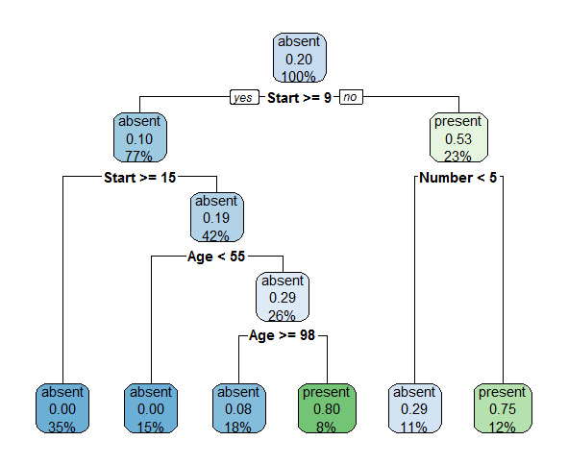
Creating the tree
model <- rpart(Kyphosis ~ ., data = training,
control = rpart.control(minsplit = 10, minbucket = 4))
rpart.plot(model)
If outcome is binary
p(Yes) is shown
Notes:
Pancreas, genotype
1

Slide 19
Exploring the results
Split rules
Kyphosis
0.00 when Start >= 15
0.00 when Start is 9 to 15 & Age < 55
0.08 when Start is 9 to 15 & Age >= 98
0.29 when Start < 9 & Number < 5
0.75 when Start < 9 & Number >= 5
0.80 when Start is 9 to 15 & Age is 55 to 98
Notes:
Pancreas, genotype
1

Slide 20
Exploring the results
Confusion matrix – training set
table(actual = training$Kyphosis,
pred = predict(model, training, type = "class"))
pred
actual absent present
absent 49 3
present 3 10
~90% correctly classified
Confusion matrix – test set
table(actual = test$Kyphosis,
pred = predict(model, test, type = "class"))
pred
actual absent present
absent 11 1
present 2 2
~81% correctly classified
Notes:
Pancreas, genotype
1

Slide 21
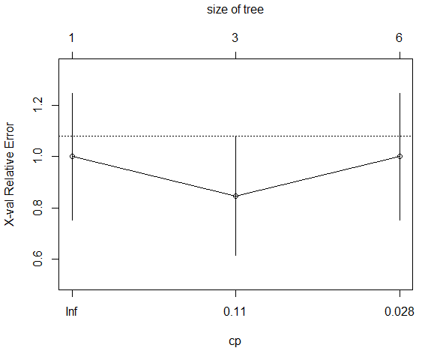
The complexity value
plotcp(model)
Notes:
Pancreas, genotype
1

Slide 22
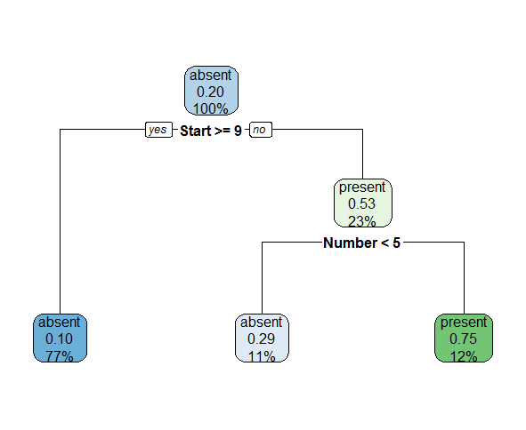
Pruning back the tree
model.pruned <- prune(model, 0.11)
Original tree
Pruned tree
~81% accuracy in both trees for the test set
Notes:
Pancreas, genotype
1

Slide 23
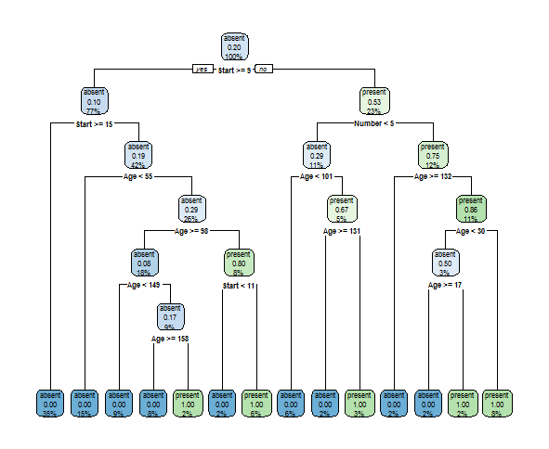
The problem with overfitting
In theory I could have perfect prediction on the training set by doing:
overfitted.model <- rpart(Kyphosis ~ ., data = training,
control = rpart.control(minsplit = 1, minbucket = 1))
Training: 100% correctly classified
Test: 62.5% correctly classified
OVERFITTING!
Notes:
Pancreas, genotype
1

Slide 24
binary trees
The problem with overfitting
Binary classification trees are
Easy to build
Easy to interpret
Easy to use
NOT ACCURATE
Notes:
Pancreas, genotype
1

Slide 25
The solution - Random Forests
The basic idea: bootstrap binary trees!
Bagging (bootstrap aggregating)
Random Forest combines the simplicity of binary tree with high accuracy!
We create a large number of trees from a bootstrapped sample of the data.
We can now hold a “vote” between all the trees to predict our new data (aggregating)
Notes:
Pancreas, genotype
1

Slide 26
Step 1 – create a bootstrap sample
Real data
Age | Sex | HR | Chol | Angina type | Chest pain | Heart disease
34 | M | 118 | 182 | 0 | 3 | 1
51 | M | 140 | 299 | 1 | 2 | 0
58 | F | 130 | 197 | 0 | 0 | 1
59 | M | 160 | 273 | 0 | 3 | 0
35 | F | 138 | 183 | 2 | 1 | 1
43 | M | 150 | 247 | 0 | 0 | 1
Bootstrapped data (1 possible sample)
Age | Sex | HR | Chol | Angina type | Chest pain | Heart disease
43 | M | 150 | 247 | 0 | 0 | 1
59 | M | 160 | 273 | 0 | 3 | 0
34 | M | 118 | 182 | 0 | 3 | 1
35 | F | 138 | 183 | 2 | 1 | 1
43 | M | 150 | 247 | 0 | 0 | 1
34 | M | 118 | 182 | 0 | 3 | 1
Notes:
Pancreas, genotype
1

Slide 27
Step 2- create a tree
We create a tree only using a random subset of classifiers at each step
Age | Sex | HR | Chol | Angina type | Chest pain
Notes:
Pancreas, genotype
1

Slide 28
Step 2- create a tree
We create a tree only using a random subset of classifiers at each step
Age | Sex | HR | Chol | Angina type | Chest pain
Notes:
Pancreas, genotype
1

Slide 29
Step 2- create a tree
We create a tree only using a random subset of classifiers at each step
Age | Sex | HR | Chol | Angina type | Chest pain
Notes:
Pancreas, genotype
1

Slide 30
We have a (random) forest!
Now repeat with a lot (hundreds) of bootstrap samples
…
Notes:
Pancreas, genotype
1

Slide 31
Now vote!
New data
Age | Sex | HR | Chol | Angina type | Chest pain
41 | F | 135 | 180 | 1 | 0
Tree | Pred
1 | 1
2 | 0
3 | 0
… | …
200 | 0
YES: 22
NO: 178
By majority vote we say that the patient is not at risk
Notes:
Pancreas, genotype
1

Slide 32
Accuracy of the Random Forest
For each tree, some of the data is not included in the bootstrap sample
This is called out-of-bag (OOB) sample
We can use these data to test each tree
The OOB error is the % of OOB observation that is misclassified
We can test the forest with different numbers of variable at each split and see which one has the least OOB error!
Notes:
Pancreas, genotype
1

Slide 33
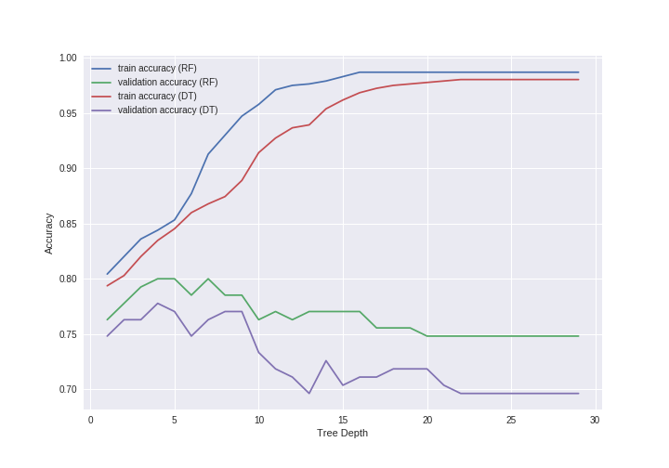
Summary
Classification trees are one of the simplest classifiers
Very easy to use but prone to overfitting
Bagging (bootstrap aggregating) can help reduce overfitting
Random Forests employs bagging on regression trees, and allow improved classification
Notes:
Pancreas, genotype
<number>

